Slide 1
KIVA Introduction NETLOGO
Muhammad Ryanda Nugraha M.
14 December 2020
Industrial Management Department
Center for Internet of Things Innovation
National Taiwan University of Science and Technology

Slide 2
Check Points

Slide 3
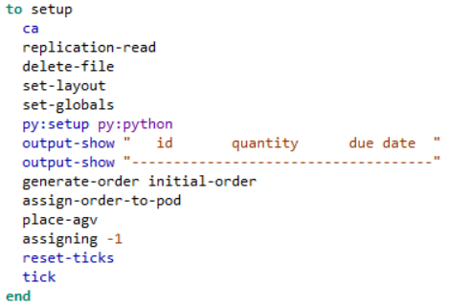

Setup
CODE
Setting up the Simulation
PROCESS FLOW
Go
Replication-read
Delete-file
CODE EXPLAINATION
Py:setup
Set globals
Set-layout
Replication-read Call function for read replication
Delete-file call function for delete file
Set-layout call function for setting layout
Output-show Function for printing
Generate-order initial-order : Function to generate order using initial-order
Assign-order-to-pod: function to assign order for the pod
place-agv: Place agv on layout
Assigning -1: Function to assign pod for AGV
Output-show
Generate-order
Assign-order-to-pod
Reset-ticks
assigning
Place-agv
ticks
End

Slide 4

SETUP
CODE
DICTIONARY
Ca : Function to choose “Celular Automaton” model
Py:setup py:python : setup python
Output-show : show output
Reset-ticks : reset tick’s counter
Tick : start tick’s counter
CODE EXPLAINATION
Replication-read Call function for read replication
Delete-file call function for delete file
Set-layout call function for setting layout
Output-show Function for printing
Generate-order initial-order : Function to generate order using initial-order
Assign-order-to-pod: function to assign order for the pod
place-agv: Place agv on layout
Assigning -1: Function to assign pod for AGV

Slide 5

Replication-read
CODE
Read replication
PROCESS FLOW
Go
Carefully[let-rep…]
CODE EXPLAINATION
Set replication
carefully[let rep_ item 0 csv:from-file "Replication.csv" set replication item 0 rep_][set replication 0]
Create temporary variable for saving “replication.csv” and then reset the value of the variable to 0

Slide 6

Replication-read
CODE
DICTIONARY
Carefully [ commands1 ] [ commands2]: Runs commands1. If a runtime error occurs inside commands1, NetLogo won't stop and alert the user that an error occurred. It will suppress the error and run commands2 instead.
Let variable value : Creates a new local variable and gives it the given value
Set variable value: Sets variable to the given value.
Item index string/list : On lists, reports the value of the item in the given list/string with the given index.
Csv: from-file filename : get item from csv with such filename
Replication.csv : An empty csv for temporary data storage
CODE EXPLAINATION
carefully[let rep_ item 0 csv:from-file "Replication.csv" set replication item 0 rep_][set replication 0]
Create temporary variable for saving “replication.csv” and then reset the value of the variable to 0

Slide 7
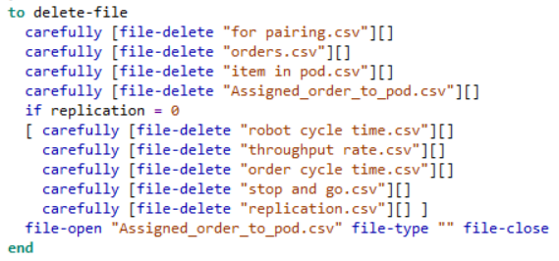
Delete-file
CODE
Read replication
PROCESS FLOW
Go
Carefully [File delete forpairing.csv]
Carefully [File-delete orders.csv]
Carefully [File-delete iteminpod.csv]
Carefully [File-delete througputrate.csv]
Carefully [File-delete robotcycletime.csv]
Carefully [Fil-delete assignedordertopod.csv]
CODE EXPLAINATION
Replication = 0
carefully [file-delete filename][]
delete filename using careful command
file-open filename file-type filetype file-close
open filename and print filetype then close the file
Carefully [File-delete ordercycletime.csv]
Carefully [File-delete stopandgo.csv]
Carefully [File-delete replication.csv]
File-open

Slide 8
Delete-file
CODE
DICTIONARY
Carefully [ commands1 ] [ commands2]: Runs commands1. If a runtime error occurs inside commands1, NetLogo won't stop and alert the user that an error occurred. It will suppress the error and run commands2 instead.
File-delete [filename] : delete [filename] file
File-open [filename] : open [filename] file
File-type [value] : Prints value to an opened file
for pairing.csv : contain data pairing purpose
orders.csv : contain order data
item in pod.csv : contain list of item in pod data
Assigned_order_to_pod.csv : contain order that assigned to the pod data
robot cycle time.csv : contain robot cycle time data
throughput rate.csv : contain throughput rate data
order cycle time.csv : contain order cycle time data
stop and go.csv : contain ticks data
CODE EXPLAINATION
carefully [file-delete filename][]
delete filename using careful command
file-open filename file-type filetype file-close
open filename and print filetype then close the file

Slide 9
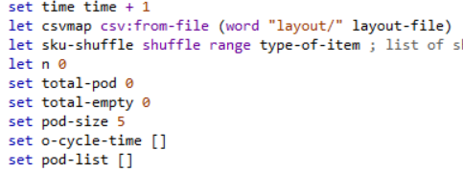
Set-layout
CODE
Setting up the Simulation’s layout
CODE EXPLAINATION
set time time + 1 : set and increment time variable
let csvmap csv:from-file (word "layout/" layout-file) : Open csv file from “layout” repository by name from layout-file variable
let sku-shuffle shuffle range type-of-item : iniatialize sky-shuffle by shuffling array with range of type of item
let n 0 : iniatialize n variable
set total-pod 0 : set total-pod variable value
set total-empty 0 : set total-empty variable value
set pod-size 5 : set pod-size variable value
set o-cycle-time [] : set o-cycle-time array
set pod-list [] : set pod-list array

Slide 10
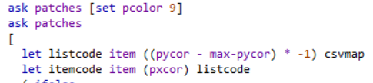
Set-layout (Cont)
CODE
Setting up the Simulation’s layout
CODE EXPLAINATION
Ask patches[set pcolor] : Set base color to 9
Ask patches - let listcode item ((pycor - max-pycor) * -1) csvmap : initialize listcode based on csvmap variable value - let itemcode item (pxcor) listcode : initialize itemcode varible based on listcode

Slide 11
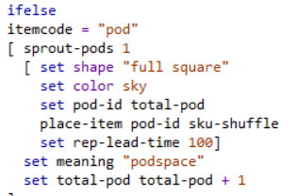
Set-layout
CODE
Setting up the Simulation’s layout
CODE EXPLAINATION
if else itemcode = [string] : Conditional for checking item code - itemcode = "pod"[ - sprout-pods 1 : create 1 pod
set shape "full square“ : set pod shape set color sky : set pod color
set pod-id total-pod : set pod-id based on current total pod
place-item pod-id sku-shuffle : call place item function for placing item based on pod-id and sku-shuffle
set rep-lead-time 100 : set rep-lead-time variable value
set meaning "podspace“ : initialize meaning
set total-pod total-pod + 1: increment for variable value

Slide 12
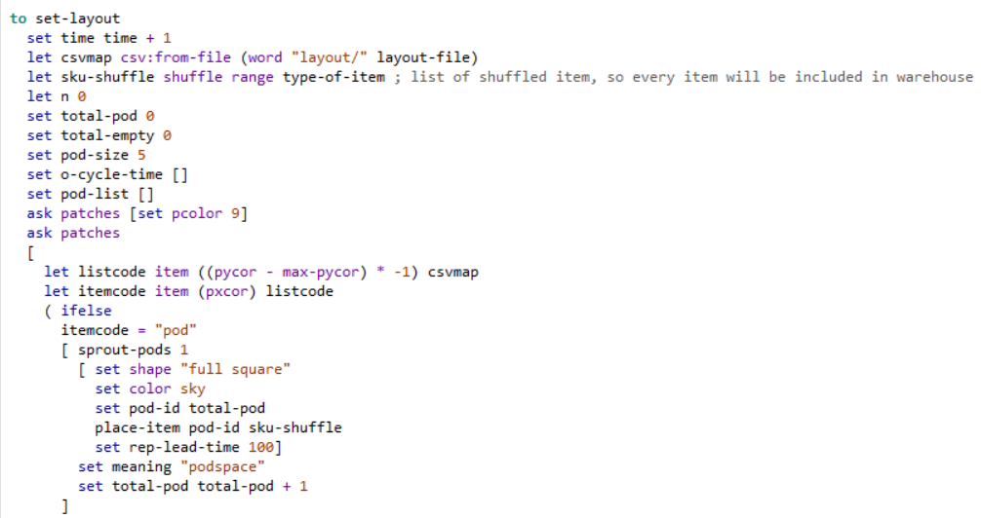
Set-layout
CODE
DICTIONARY
Ask patches … : Command every patches
Ifelse : Conditional if
Shuffle : shuffling list randomly
Range [range] : Generate list within\ range of [Range]
csv:from-file … : open csv file from given folder and its name
Word [value] : Declaring string with [value}
Sprout : Sprouting item (pod,empty,etc)

Slide 13
Set-layout (Cont)
CODE
Setting up the Simulation’s layout
CODE EXPLAINATION
let que-size item 0 sort [xcor] of turtles with [shape = "int7"] - item 0 sort [xcor] of picking-stations : initialize que-size with turtle that have shape “int7” after sorted based on xcor minus picking-stations
ask picking-stations [set entering-queue xcor + que-size]: call function picking-stations for set entering-que with xcor+que-size
ask turtles with [shape = "int7"][die]: Ask each turtle with shape “int7” to die

Slide 14
Set-layout (Cont)
CODE
Setting up the Simulation’s layout
DICTIONARY
sort : sorting list
sorting agentset
of : [reporter] of agent
[reporter] of agentset
with : agentset with [reporter]

Slide 15
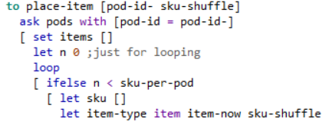
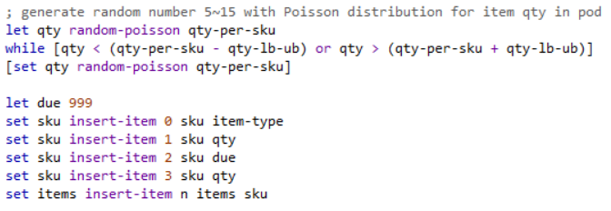
Place item
CODE
Placing item based on pod id
CODE EXPLAINATION
ask pods with [pod-id = pod-id-] : ask pod based on pod-id
set items : set item as empty array
let n 0 : set n value
loop : initialize looping
ifelse n < sku-per-pod : conditional if n < sku-per-pod
let sku [] : set sku as empty array
let item-type item item-now sku-shuffle : set item-type on item-now index
let qty random-poisson qty-per-sku :generate random number with poisson distribution
while [qty < (qty-per-sku - qty-lb-ub) or qty > (qty-per- sku + qty-lb-ub)] [set qty random-poisson qty-per- sku] : set a while loop based on given condition
let due 999 : set due value
set sku insert-item 0 sku item-type : insert an item-type value to sku list that located on given index
set items insert-item n items sku: insert a sku value to items list that located on given index

Slide 16
Place item
CODE
Placing item based on pod id
DICTIONARY
loop [ commands ] : Repeats the commands forever, or until the enclosing procedure exits through use of the stop or report commands.
random-poisson mean : random-poisson reports a Poisson-distributed random integer based on given mean
while [reporter] [ commands ]: If reporter reports false, exit the loop. Otherwise run commands and repeat
insert-item index list value/item : On a list, inserts an item in that list. index is the location where the item will be inserted. The first item has an index of 0.

Slide 17
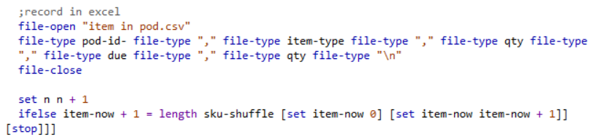
Place item (Cont)
CODE
Placing item based on pod id
CODE EXPLAINATION
file-open "item in pod.csv“ : open given filename
file-type pod-id- file-type "," file-type item-type file-type "," file-type qty file-type "," file-type due file-type "," file-type qty file-type "\n“ : write given value
file-close : closed currently opened file
set n n + 1 : increment value of n
ifelse item-now + 1 = length sku-shuffle [set item-now 0] [set item-now item-now + 1]] : conditional IF that check whether or not item-now + 1 = length sku-shuffle then do first command or second one based on the result
[stop] : stop the loop

Slide 18
Place item (cont)
CODE
Placing item based on pod id
DICTIONARY
File-open [filename]: open [filename] file
File-type [value] : Prints value to an opened file
File-close : close currently opened file
Stop : stop currently active loops

Slide 19
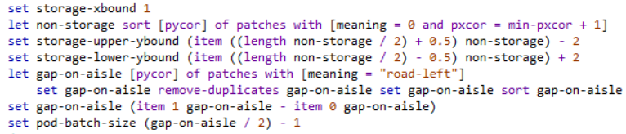
Set-global
CODE
Setting up the Simulation’s global variable
CODE EXPLAINATION
set storage-xbound 1 : set storage-xbound variable value
let non-storage sort [pycor] of patches with [meaning = 0 and pxcor = min-pxcor + 1] : change value of non-storage based on patches with condition (meaning = 0 and pxcor=min-pxcor+1) by sorting pycor array first
set storage-upper-ybound (item ((length non-storage / 2) + 0.5) non-storage) – 2 : set storage-upper-ybound value based on item on certain index (From non-storage)
set storage-lower-ybound (item ((length non-storage / 2) - 0.5) non-storage) + 2 : set storage-lower-ybound value based on item on certain index (From non-storage)
let gap-on-aisle [pycor] of patches with [meaning = "road-left"] set gap-on-aisle remove-duplicates gap-on-aisle set gap-on-aisle sort gap-on-aisle : change value of gap-on-aisle using pycor and patches with condition(meaning = road-left) then remove the duplicates and sort them
set gap-on-aisle (item 1 gap-on-aisle - item 0 gap-on-aisle) : set gap-on-aisle variable value based on first and second index item from gap-on-aisle array
set pod-batch-size (gap-on-aisle / 2) – 1 : set pod-batch-size value

Slide 20
Set-global
CODE
Setting up the Simulation’s global variable
DICTIONARY
Remove-duplicates list : Reports a copy of list with all duplicate items removed
Item index list : On lists, reports the value of the item in the given list with the given index.
Length list/string : Reports the number of items in the given list, or the number of characters in the given string.

Slide 21
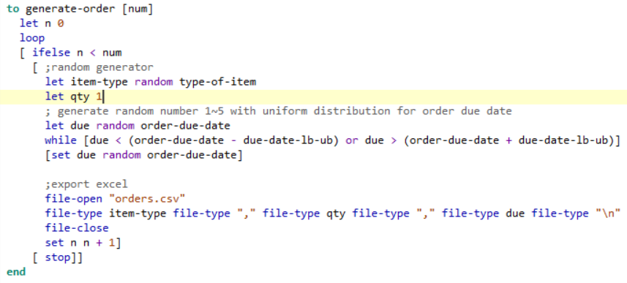
generate-order
CODE
Generating Order for Simulation
CODE EXPLAINATION
Loop : start loop
ifelse n < num : Check condition
let item-type random type-of-item : Choose random value from type-of-item to be assigned as item-type value
let due random order-due-date : Choose random value from order-due-date to be assigned as due value
while [due < (order-due-date - due-date-lb-ub) or due > (order-due-date + due-date-l)][set due random order-due-date] : Setting loop while condition b-ubof [due < (order-due-date - due-date-lb-ub) or due > (order-due-date + due-date-lb-ub)] still true, repeat command of [set due random order-due-date]
file-open "orders.csv“ : Open csv file
file-type item-type file-type "," file-type qty file-type "," file-type due file-type "\n“ : Write on csv file
file-close : Close file
Stop : Stop the loop

Slide 22
generate-order
CODE
Generating Order for Simulation
DICTIONARY
while [reporter] [ commands ] : If reporter reports false, exit the loop. Otherwise run commands and repeat.

Slide 23
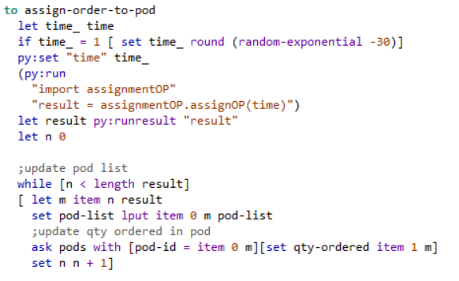
Assign-order-to-pod
CODE
Assigning each order to the pod
CODE EXPLAINATION
let time_ time : Initialize time variable value
if time_ = 1 [ set time_ round (random-exponential -30)] :. Set time_ with value of rounded random exponential value minus 30 if condition is true
py:set "time" time_ : Set variable value for python
(py:run : Run python
"import assignmentOP“ : import assignmentOP
"result = assignmentOP.assignOP(time)") : initialize value of result
let result py:runresult "result“ : “Transfering” value from python code to netlogo
while [n < length result] : While the condition true, run command below
[ let m item n result : Initialize m using item from result list with n index
set pod-list lput item 0 m pod-list insert new value to pod-list using first item m
ask pods with [pod-id = item 0 m][set qty-ordered item 1 m] : Command pod with pod-id = first item of m list to set qty-ordered item with item with n-index from m list
set n n + 1: increment n value

Slide 24
Assign-order-to-pod
CODE
Assigning each order to the pod
DICTIONARY
lput value list : Adds value to the end of a list and reports the new list.
random-exponential mean : random-exponential reports an exponentially distributed random floating point number. It is equivalent to (- mean) * ln random-float 1.0.

Slide 25
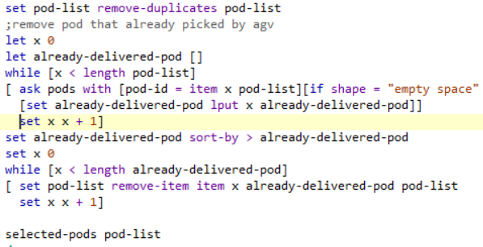
Assign-order-to-pod (Cont)
CODE
Assigning each order to the pod
CODE EXPLAINATION
set pod-list remove-duplicates pod-list : remove duplicate entry from pod-list that already picked by agv
let already-delivered-pod [] : Initialize an array
while [x < length pod-list] : While condition return true, repeat command
[ ask pods with [pod-id = item x pod-list][if shape = "empty space" : command pod with such condition, and if shape equal to “empty space” do command below
[set already-delivered-pod lput x already-delivered-pod]] : insert item to array using value from x-index on list
set x x + 1] : increment x value
set already-delivered-pod sort-by > already-delivered-pod :Sort the array with descending order
while [x < length already-delivered-pod] : while condition return true, run command below
[ set pod-list remove-item item x already-delivered-pod pod-list : remove item from pod-list list based on already-delivered-pod list item on x-index
selected-pods pod-list : call selected-pods function

Slide 26
Assign-order-to-pod (Cont)
CODE
Assigning each order to the pod
DICTIONARY
sort-by reporter list : If the input is a list, reports a new list containing the same items as the input list, in a sorted order defined by the boolean reporter. reporter may be an anonymous reporter or the name of a reporter. Use > for descending, and < for ascending

Slide 27
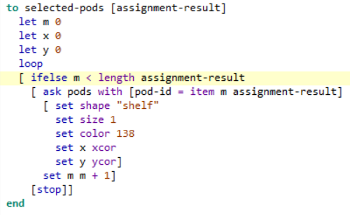
Selected-pods
CODE
Flag selected pods based on assignment result
CODE EXPLAINATION
loop : Start loop
ifelse m < length assignment-result : conditional to compare of m with assignment-result size
ask pods with [pod-id = item m assignment-result] command pod with pod-id equal to item from assignment-result on m-index
set shape "shelf“ : set pod shape
set size 1 : set pod size
set color 138 : set pod color
set x xcor : set pod x-coordinate
set y ycor : set pod y-coordinate
set m m + 1 : increment m variable
stop : stop loop

Slide 28
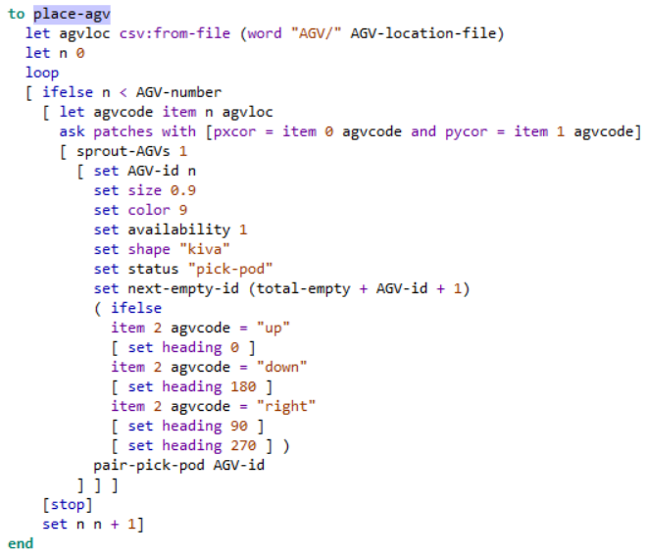
Place-agv
CODE
Place agv on simulation environtment
CODE EXPLAINATION
let agvloc csv:from-file (word "AGV/" AGV-location-file) : open file from AGV repository and assign it as agvloc value
let n 0 : assign 0 as value of n
loop : start loop
[ ifelse n < AGV-number : check if n is lower than agv-number
[ let agvcode item n agvloc : assign n-index item of agvloc as value of agvcode
ask patches with [pxcor = item 0 agvcode and pycor = item 1 agvcode] : command patch with pxcor equal to index 0 item of agvcode and with pxcor equal to index 1 item of agvcode
[ sprout-AGVs 1 : call function sprout-AGVs with passing value of 1
[ set AGV-id n : set agv-id value
set size 0.9 : set size value
set color 9:set color value
set availability 1 : set availability value
set shape "kiva“ : set shape value
set status "pick-pod“ : set status value
set next-empty-id (total-empty + AGV-id + 1) : set next-empty-id value
( ifelse : conditional if
item 2 agvcode = "up“ : check if agvcode on index 2 is equal to “up”
[ set heading 0 ] : if condition above return true set heading value to 0
item 2 agvcode = "down“ : check if agvcode on index 2 is equal to “down”
[ set heading 180 ] : if condition above return true set heading value to 180
item 2 agvcode = "right“ : check if agvcode on index 2 is equal to “right”
[ set heading 90 ] : if condition above return true set heading value to 90
[ set heading 270 ] ) : if no condition above return true, set heading value to 270
pair-pick-pod AGV-id : call pair-pick-pod function and pass agv-id value
[stop] : stop loop
set n n + 1] : increment n value

Slide 29
Place-agv
CODE
Place agv on simulation environtment
DICTIONARY
csv:from-file "/path/to/myfile.csv“ : Open csv file from given path, then assign it as a variable’s value

Slide 30
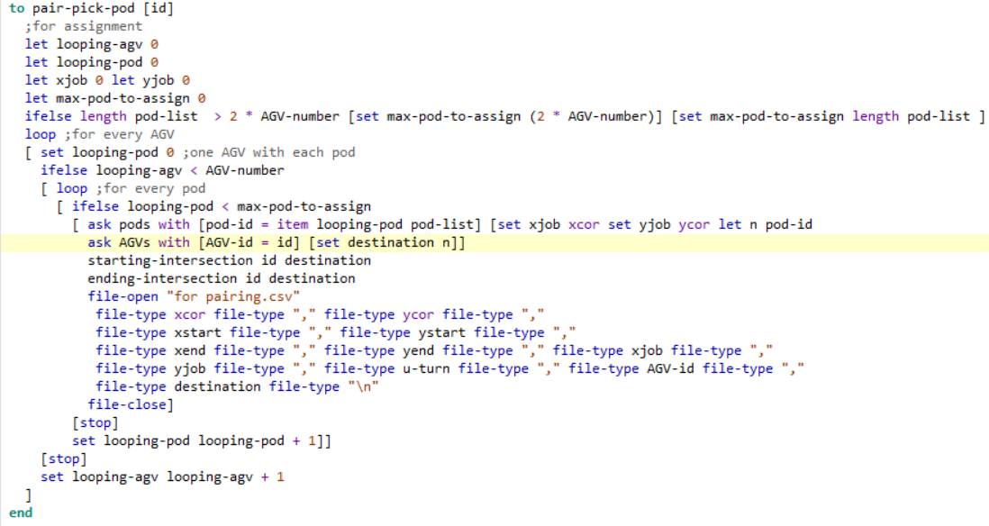
Pair-pick-pod
CODE
Pairing for pickup pod
CODE EXPLAINATION
let looping-agv 0 : initialize looping-agv value with 0
let looping-pod 0 : initialize looping-pod value with 0
let xjob 0 let yjob 0 : initialize xjob and xjob value with 0
let max-pod-to-assign 0 : initialize max-pod-to-assign value with 0
ifelse length pod-list > 2 * AGV-number [set max-pod-to-assign (2 * AGV-number)] [set max-pod-to-assign length pod-list ] :If given condition return true, do first command, else do second command
loop :start loop
[ set looping-pod 0 ;one AGV with each pod : : set looping-pod value with 0
ifelse looping-agv < AGV-number : If given condition return true, do first command, else do second command
[ loop : start loop
[ ifelse looping-pod < max-pod-to-assign : If given condition return true, do first command, else do second command
[ ask pods with [pod-id = item looping-pod pod-list] [set xjob xcor set yjob ycor let n pod-id ask AGVs with [AGV-id = id] [set destination n]] : ask pod with given condition to do command
starting-intersection id destination : call starting-intersection function
ending-intersection id destination : call starting-intersection function
file-open "for pairing.csv“ : open file
file-type xcor file-type "," file-type ycor file-type "," file-type xstart file-type "," file-type ystart file-type "," file-type xend file-type "," file-type yend file-type "," file-type xjob file-type "," file-type yjob file-type "," file-type u-turn file-type "," file-type AGV-id file-type "," file-type destination file-type "\n“ : print on file
file-close] : closing file
[stop] : stop loop
set looping-pod looping-pod + 1]] : increment for looping-pod
[stop] : stop loop
set looping-agv looping-agv + 1 : increment for looping-pod

Slide 31
Pair-pick-pod
CODE
Pairing for pickup pod
CODE EXPLAINATION
let looping-agv 0 : initialize looping-agv value with 0
let looping-pod 0 : initialize looping-pod value with 0
let xjob 0 let yjob 0 : initialize xjob and xjob value with 0
let max-pod-to-assign 0 : initialize max-pod-to-assign value with 0
ifelse length pod-list > 2 * AGV-number [set max-pod-to-assign (2 * AGV-number)] [set max-pod-to-assign length pod-list ] :If given condition return true, do first command, else do second command
loop :start loop
[ set looping-pod 0 ;one AGV with each pod : : set looping-pod value with 0
ifelse looping-agv < AGV-number : If given condition return true, do first command, else do second command
[ loop : start loop
[ ifelse looping-pod < max-pod-to-assign : If given condition return true, do first command, else do second command
[ ask pods with [pod-id = item looping-pod pod-list] [set xjob xcor set yjob ycor let n pod-id ask AGVs with [AGV-id = id] [set destination n]] : ask pod with given condition to do command
starting-intersection id destination : call starting-intersection function
ending-intersection id destination : call starting-intersection function
file-open "for pairing.csv“ : open file
file-type xcor file-type "," file-type ycor file-type "," file-type xstart file-type "," file-type ystart file-type "," file-type xend file-type "," file-type yend file-type "," file-type xjob file-type "," file-type yjob file-type "," file-type u-turn file-type "," file-type AGV-id file-type "," file-type destination file-type "\n“ : print on file
file-close] : closing file
[stop] : stop loop
set looping-pod looping-pod + 1]] : increment for looping-pod
[stop] : stop loop
set looping-agv looping-agv + 1 : increment for looping-pod

Slide 32
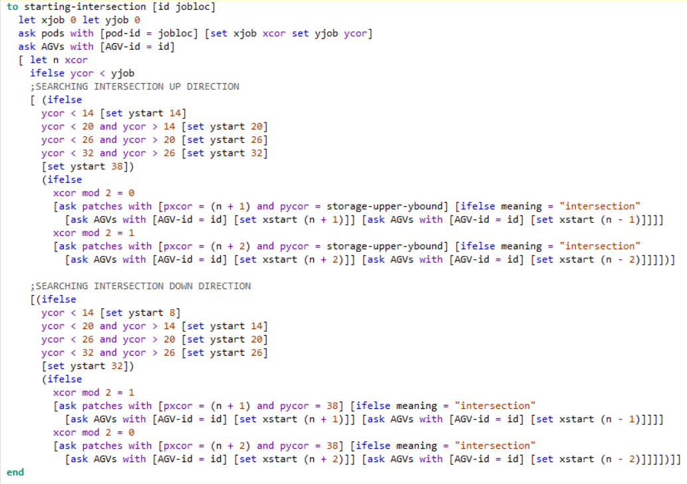
Starting-intersection
CODE
Search for starting intersection
CODE EXPLAINATION
let xjob 0 let yjob 0 : initialize xjob and yjob value
ask pods with [pod-id = jobloc] [set xjob xcor set yjob ycor] : ask pods with given condition to do given command
ask AGVs with [AGV-id = id] : ask AGV with given condition to do given command
[ let n xcor : initialize xjob and yjob value
ifelse ycor < yjob : if condtion checking return true, do command below
;SEARCHING INTERSECTION UP DIRECTION
[ (ifelse : if condtion checking return true, do given command
ycor < 14 [set ystart 14] : first condition and command
ycor < 20 and ycor > 14 [set ystart 20] : second condition and command
ycor < 26 and ycor > 20 [set ystart 26] : third condition and command
ycor < 32 and ycor > 26 [set ystart 32]: forth condition and command
[set ystart 38]) : if all other condition not fulfilled and do this command
(ifelse : if condtion checking return true, do given command
xcor mod 2 = 0 : given condtion for conditional if xcor is even number
[ask patches with [pxcor = (n + 1) and pycor = storage-upper-ybound] [ifelse meaning = "intersection" : ask patches with given condition to do given command
[ask AGVs with [AGV-id = id] [set xstart (n + 1)]] [ask AGVs with [AGV-id = id] [set xstart (n - 1)]]]] : ask patches with given condition to do given command
xcor mod 2 = 1 : given condtion for conditional if xcor is odd number
[ask patches with [pxcor = (n + 2) and pycor = storage-upper-ybound] [ifelse meaning = "intersection" : ask patches with given condition to do given command
[ask AGVs with [AGV-id = id] [set xstart (n + 2)]] [ask AGVs with [AGV-id = id] [set xstart (n - 2)]]]])] : ask pods with given condition to do given command

Slide 33
Starting-intersection (Cont)
CODE
Search for starting intersection
CODE EXPLAINATION
;SEARCHING INTERSECTION DOWN DIRECTION
[(ifelse : : if condtion checking return true, do given command
ycor < 14 [set ystart 8] : first condition and command
ycor < 20 and ycor > 14 [set ystart 14] : second condition and command
ycor < 26 and ycor > 20 [set ystart 20] : third condition and command
ycor < 32 and ycor > 26 [set ystart 26] ; forth condition and command
[set ystart 32]) : if all other condition not fulfilled and do this command
(ifelse : if condtion checking return true, do given command
xcor mod 2 = 1 given condtion for conditional if xcor is odd number
[ask patches with [pxcor = (n + 1) and pycor = 38] [ifelse meaning = "intersection" : ask patches with given condition to do given command
[ask AGVs with [AGV-id = id] [set xstart (n + 1)]] [ask AGVs with [AGV-id = id] [set xstart (n - 1)]]]] : ask agvs with given condition to do given command
xcor mod 2 = 0 given condtion for conditional if xcor is even number
[ask patches with [pxcor = (n + 2) and pycor = 38] [ifelse meaning = "intersection" : ask patches with given condition to do given command
[ask AGVs with [AGV-id = id] [set xstart (n + 2)]] [ask AGVs with [AGV-id = id] [set xstart (n - 2)]]]])]] : ask patches with given condition to do given command

Slide 34
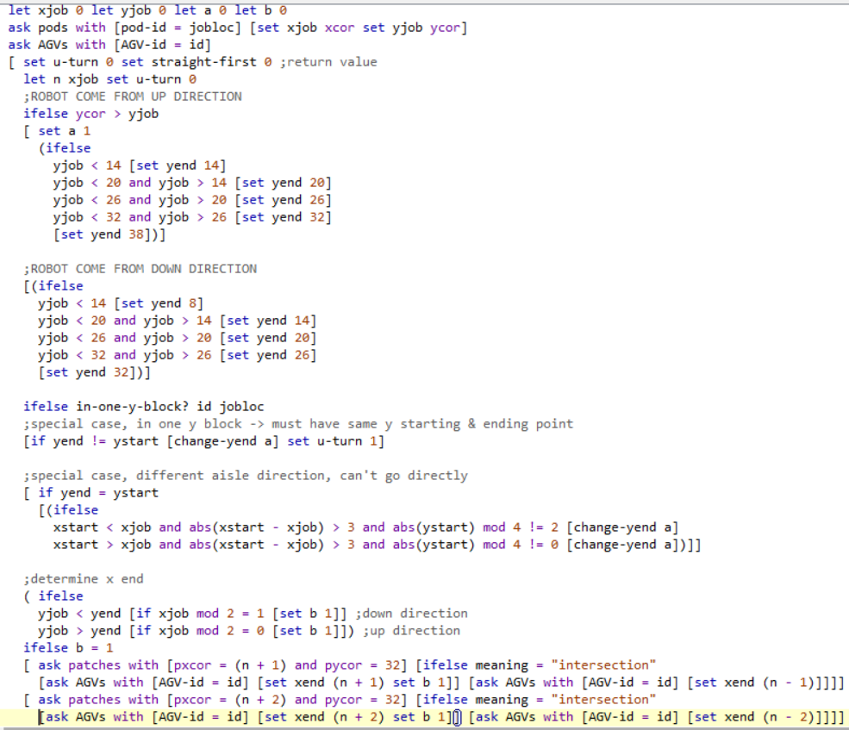
Ending-intersection
CODE
Search for ending intersection
CODE EXPLAINATION
let xjob 0 let yjob 0 let a 0 let b 0 : initialize variables and its value
ask pods with [pod-id = jobloc] [set xjob xcor set yjob ycor] : ask patches with given condition to do given command
ask AGVs with [AGV-id = id] : ask patches with given condition to do command below
[ set u-turn 0 set straight-first 0 ;return value : setting up variables and its value
let n xjob set u-turn 0 : : initialize variables and its value
;ROBOT COME FROM UP DIRECTION
ifelse ycor > yjob : if condtion checking return true, do given command
[ set a 1 : setting up variables and its value
(ifelse : if condtion checking return true, do given command
yjob < 14 [set yend 14] : first condition and command
yjob < 20 and yjob > 14 [set yend 20] : second condition and command
yjob < 26 and yjob > 20 [set yend 26] : third condition and command
yjob < 32 and yjob > 26 [set yend 32] : forth condition and command
[set yend 38])] : if all other condition not fulfilled and do this command
;ROBOT COME FROM DOWN DIRECTION
[(ifelse if condtion checking return true, do given command
yjob < 14 [set yend 8] : first condition and command
yjob < 20 and yjob > 14 [set yend 14] : second condition and command
yjob < 26 and yjob > 20 [set yend 20] : third condition and command
yjob < 32 and yjob > 26 [set yend 26] : forth condition and command
[set yend 32])] : : if all other condition not fulfilled and do this command

Slide 35
Ending-intersection (Cont)
CODE
Search for ending intersection
CODE EXPLAINATION
ifelse in-one-y-block? id jobloc : if condtion checking using given function return true, do given command
;special case, in one y block -> must have same y starting & ending point
[if yend != ystart [change-yend a] set u-turn 1] : if condtion checking return true, do given command
;special case, different aisle direction, can't go directly
[ if yend = ystart:if condtion checking return true, do given command
[(ifelse : if condtion checking return true, do given command
xstart < xjob and abs(xstart - xjob) > 3 and abs(ystart) mod 4 != 2 [change-yend a] : first condition and command
xstart > xjob and abs(xstart - xjob) > 3 and abs(ystart) mod 4 != 0 [change-yend a])]] : second condition and command
;determine x end
( ifelse : if condtion checking return true, do given command
yjob < yend [if xjob mod 2 = 1 [set b 1]] ;down direction : first condition and command
yjob > yend [if xjob mod 2 = 0 [set b 1]]) ;up direction : first condition and command
ifelse b = 1 : if condtion checking return true, do given command

Slide 36
Ending-intersection (Cont)
CODE
Search for ending intersection
CODE EXPLAINATION
[ ask patches with [pxcor = (n + 1) and pycor = 32] [ifelse meaning = "intersection" [ask AGVs with [AGV-id = id] [set xend (n + 1) set b 1]] [ask AGVs with [AGV-id = id] [set xend (n - 1)]]]] : ask patches with given condition to do given command
[ ask patches with [pxcor = (n + 2) and pycor = 32] [ifelse meaning = "intersection" [ask AGVs with [AGV-id = id] [set xend (n + 2) set b 1]] [ask AGVs with [AGV-id = id] [set xend (n - 2)]]]] : ask patches with given condition to do given command
set path-status "go-to-aisle“ : set variable and its value

Slide 37
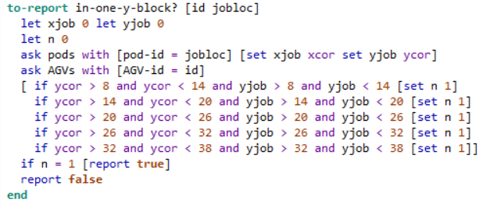
In-one-y-b-block
CODE
Check if given id is on one vertical block
CODE EXPLAINATION
let xjob 0 let yjob 0 : initalize variable and its value
let n 0 : : initalize variable and its value
ask pods with [pod-id = jobloc] [set xjob xcor set yjob ycor] : ask patches with given condition to do given command
ask AGVs with [AGV-id = id] : ask patches with given condition to do given command based on given condition
[ if ycor > 8 and ycor < 14 and yjob > 8 and yjob < 14 [set n 1] : first condition and command
if ycor > 14 and ycor < 20 and yjob > 14 and yjob < 20 [set n 1] : second condition and command
if ycor > 20 and ycor < 26 and yjob > 20 and yjob < 26 [set n 1] : third condition and command
if ycor > 26 and ycor < 32 and yjob > 26 and yjob < 32 [set n 1] : forth condition and command
if ycor > 32 and ycor < 38 and yjob > 32 and yjob < 38 [set n 1]] forth condition and command
if n = 1 [report true] : condition that return true
report false : : condition that return false

Slide 38
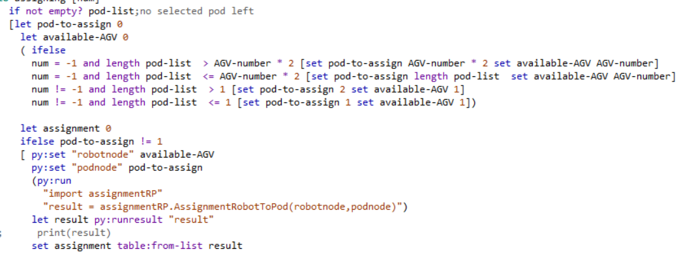
Assigning
CODE
Assigning both pod with available agv
CODE EXPLAINATION
if not empty? pod-list;no selected pod left : Check if given list is empty or not then do given command
[let pod-to-assign 0 : initalize variable and its value
let available-AGV 0 : initalize variable and its value
( ifelse : if condition checking return true, do given command
num = -1 and length pod-list > AGV-number * 2 [set pod-to-assign AGV-number * 2 set available-AGV AGV-number] : first condition and command
num = -1 and length pod-list <= AGV-number * 2 [set pod-to-assign length pod-list set available-AGV AGV-number] : second condition and command
num != -1 and length pod-list > 1 [set pod-to-assign 2 set available-AGV 1] : third condition and command
num != -1 and length pod-list <= 1 [set pod-to-assign 1 set available-AGV 1]) : forth condition and command
let assignment 0 : initalize variable and its value
ifelse pod-to-assign != 1 if condition checking return true, do given command
[ py:set "robotnode" available-AGV : passing netlogo variable value to python variables
py:set "podnode" pod-to-assign : available-AGV : passing netlogo variable value to python variables
(py:run : run python command
"import assignmentRP“ : python command
"result = assignmentRP.AssignmentRobotToPod(robotnode,podnode)") : python command
let result py:runresult "result“ : passing python variable value to netlogo variables
set assignment table:from-list result : set variable and its value

Slide 39
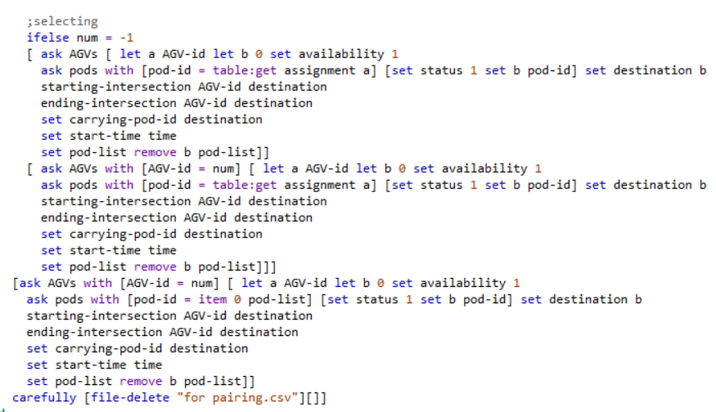
Assigning (CONT)
CODE
Assigning both pod with available agv
CODE EXPLAINATION
ifelse num = -1 : initalize variable and its value
[ ask AGVs [ let a AGV-id let b 0 set availability 1
ask pods with [pod-id = table:get assignment a] [set status 1 set b pod-id] set destination b : ask AGV with given condition to do given command
starting-intersection AGV-id destination : call function of starting-intersection
ending-intersection AGV-id destination : call function of ending-intersection
set carrying-pod-id destination : setting variable and its value
set start-time time : setting variable and its value
set pod-list remove b pod-list]] : : setting variable and its value
[ ask AGVs with [AGV-id = num] [ let a AGV-id let b 0 set availability 1
ask pods with [pod-id = table:get assignment a] [set status 1 set b pod-id] set destination b : ask AGV with given condition to do given command
starting-intersection AGV-id destination
ending-intersection AGV-id destination
set carrying-pod-id destination : setting variable and its value
set start-time time : setting variable and its value
set pod-list remove b pod-list]]] : setting variable and its value
[ask AGVs with [AGV-id = num] [ let a AGV-id let b 0 set availability 1
ask pods with [pod-id = item 0 pod-list] [set status 1 set b pod-id] set destination b
starting-intersection AGV-id destination : call function of starting-intersection
ending-intersection AGV-id destination : call function of ending-intersection
set carrying-pod-id destination : setting variable and its value
set start-time time : setting variable and its value
set pod-list remove b pod-list]] : setting variable and its value
carefully [file-delete "for pairing.csv"][]] : delete given file using carefully method

Slide 40
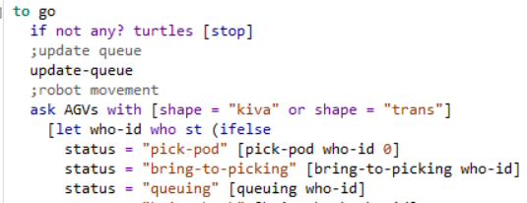
GO
CODE
Act as main function of the simulation
CODE EXPLAINATION
if not any? turtles [stop] : Check if there’s a turtle or nto
update-queue : call function update-queue
ask AGVs with [shape = "kiva" or shape = "trans"] : command AGV with given condition to do given command
[let who-id who st : Initialize variable with turtle id
(ifelse : check condition and do command based on the condition
status = "pick-pod" [pick-pod who-id 0] : First condition and command
status = "bring-to-picking" [bring-to-picking who-id] : Second condition and command
status = "queuing" [queuing who-id] : Third condition and command

Slide 41
GO
CODE
Act as main function of the simulation
DICTIONARY
not Boolean : Reports true if boolean is false, otherwise reports false.
any? Agentset : Reports true if the given agentset is non-empty, false otherwise.
Who : This is a built-in turtle variable. It holds the turtle's "who number" or ID number, an integer greater than or equal to zero. You cannot set this variable; a turtle's who number never changes.
St : The turtle becomes visible again.

Slide 42
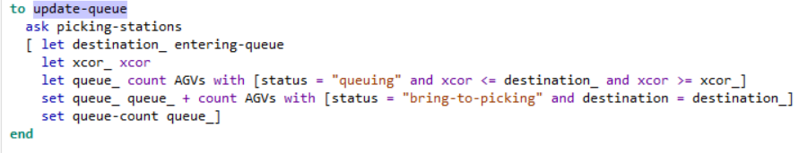
Update-queue
CODE
For updating queue of simulation’s AGV
CODE EXPLAINATION
ask picking-stations : command picking-station
[ let destination_ entering-queue : initialize variable’s value
let xcor_ xcor : initialize variable’s value
let queue_ count AGVs with [status = "queuing" and xcor <= destination_ and xcor >= xcor_] : initialize variable’s value with the number of AGV with given condition
set queue_ queue_ + count AGVs with [status = "bring-to-picking" and destination = destination_] : initialize variable’s value with the number of AGV with given condition
set queue-count queue_] : initialize variable’s value

Slide 43
Update-queue
CODE
For updating queue of simulation’s AGV
DICTIONARY
count agentset : Reports the number of agents in the given agentset.

Slide 44
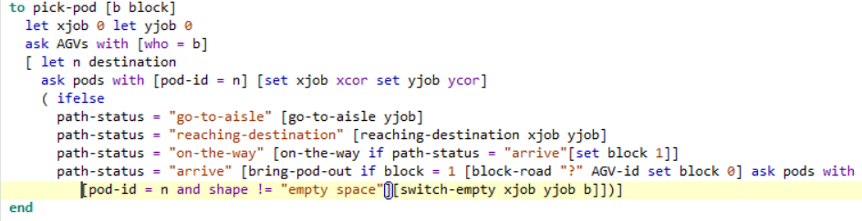
Pick-pod
CODE
Picking up for pod
CODE EXPLAINATION
let xjob 0 let yjob 0 : initialize variable’s value
ask AGVs with [who = b] : command AGV with given condition
[ let n destination : initialize variable’s value
ask pods with [pod-id = n] [set xjob xcor set yjob ycor] : command AGV with given condition to do given command
( ifelse : conditional to check each path-status
path-status = "go-to-aisle" [go-to-aisle yjob] : first condition and command
path-status = "reaching-destination" [reaching-destination xjob yjob] : second condition and command
path-status = "on-the-way" [on-the-way if path-status = "arrive"[set block 1]] : third condition and command
path-status = "arrive" [bring-pod-out if block = 1 [block-road "?" AGV-id set block 0] ask pods with
[pod-id = n and shape != "empty space"][switch-empty xjob yjob b]])] : forth condition and command

Slide 45
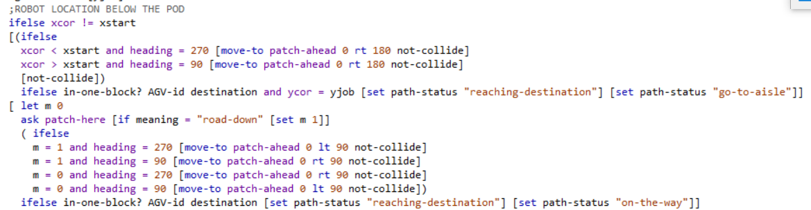
go-to-aisle
CODE
If robot is below the pod
CODE EXPLAINATION
ifelse xcor != xstart : conditional checking
[(ifelse : conditional checking
xcor < xstart and heading = 270 [move-to patch-ahead 0 rt 180 not-collide] : first command and condition
xcor > xstart and heading = 90 [move-to patch-ahead 0 rt 180 not-collide] : second command and condition
[not-collide]) : third command and condition
ifelse in-one-block? AGV-id destination and ycor = yjob [set path-status "reaching-destination"] [set path-status "go-to-aisle"]] : conditional checking
[ let m 0
ask patch-here [if meaning = "road-down" [set m 1]] : command patch-here with given command
( ifelse : conditional checking
m = 1 and heading = 270 [move-to patch-ahead 0 lt 90 not-collide]: first command and condition
m = 1 and heading = 90 [move-to patch-ahead 0 rt 90 not-collide] ]: second command and condition
m = 0 and heading = 270 [move-to patch-ahead 0 rt 90 not-collide] :third command and condition
m = 0 and heading = 90 [move-to patch-ahead 0 lt 90 not-collide]) : forth command and condition
ifelse in-one-block? AGV-id destination [set path-status "reaching-destination"] [set path-status "on-the-way"]] : conditional checking

Slide 46
go-to-aisle
CODE
If robot is below the pod
DICTIONARY
boolean1 and boolean2 : Reports true if both boolean1 and boolean2 are true. Otherwise reports false.
Heading : This is a built-in turtle variable. It indicates the direction the turtle is facing. This is a number greater than or equal to 0 and less than 360. 0 is north, 90 is east, and so on. You can set this variable to make a turtle turn. move-to agent : The turtle sets its x and y coordinates to be the same as the given agent's.
patch-ahead distance : Reports the single patch that is the given distance "ahead" of this turtle, that is, along the turtle's current heading. Reports nobody if the patch does not exist because it is outside the world.

Slide 47
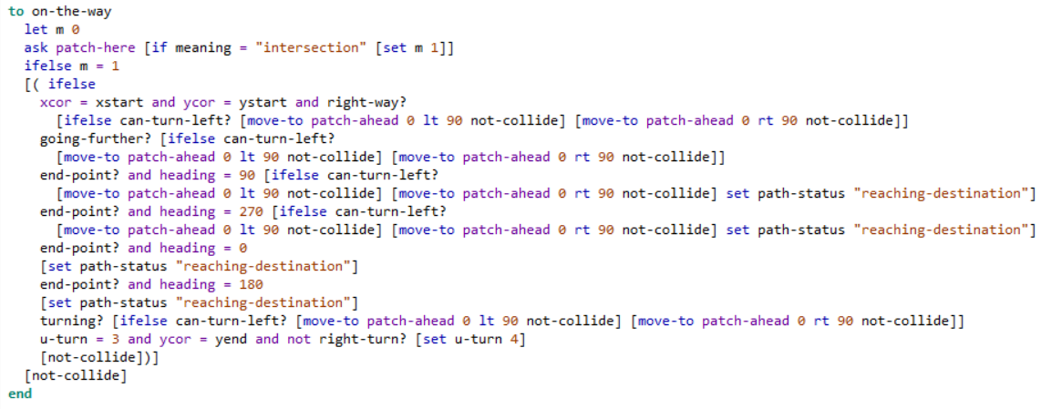
On-the-way
Function that define AGV movement
CODE
CODE EXPLAINATION
let m 0 : initialize variable’s value
ask patch-here [if meaning = "intersection" [set m 1]] : command patch-here that have given condtion to do command below
ifelse m = 1 : conditional checking
[( ifelse xcor = xstart and ycor = ystart and right-way? : conditional checking
[ifelse can-turn-left? [move-to patch-ahead 0 lt 90 not-collide] [move-to patch-ahead 0 rt 90 not-collide]] : First condition and command
going-further? [ifelse can-turn-left? [move-to patch-ahead 0 lt 90 not-collide] [move-to patch-ahead 0 rt 90 not-collide]] : Second condition and command
end-point? and heading = 90 [ifelse can-turn-left? [move-to patch-ahead 0 lt 90 not-collide] [move-to patch-ahead 0 rt 90 not-collide] set path-status "reaching-destination"] : Third condition and command
end-point? and heading = 270 [ifelse can-turn-left? [move-to patch-ahead 0 lt 90 not-collide] [move-to patch-ahead 0 rt 90 not-collide] set path-status "reaching-destination"] : Forth condition and command
end-point? and heading = 0 [set path-status "reaching-destination"] : Fifth condition and command
end-point? and heading = 180 [set path-status "reaching-destination"] : Sixth
turning? [ifelse can-turn-left? [move-to patch-ahead 0 lt 90 not-collide] [move-to patch-ahead 0 rt 90 not-collide]] : Seventh condition and command
u-turn = 3 and ycor = yend and not right-turn? [set u-turn 4] : Check if there’s a u-turn
[not-collide])] : If no other condition fulfilled and do this command
[not-collide] : If no other condition fulfilled and do this command

Slide 48
On-the-way
Function that define AGV movement
CODE
DICTIONARY
Lt/left number : The turtle turns left by number degrees. (If number is negative, it turns right.)
Rt/right number : The turtle turns right by number degrees. (If number is negative, it turns left.)

Slide 49
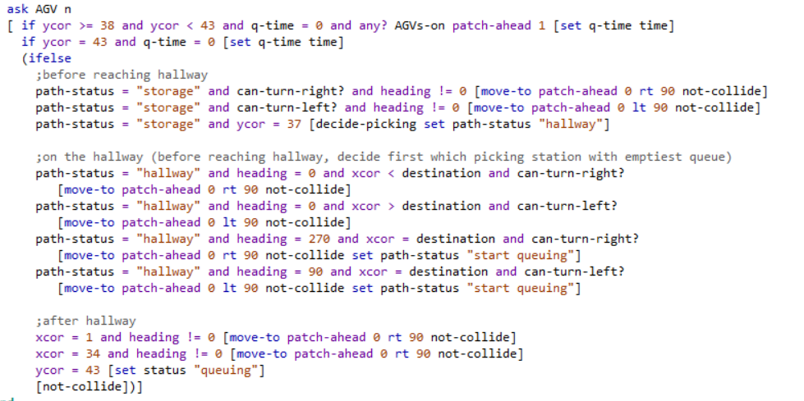
Bring-to-picking
Function that define AGV movement to picking station
CODE
CODE EXPLAINATION
ask AGV n [ if ycor >= 38 and ycor < 43 and q-time = 0 and any? AGVs-on patch-ahead 1 [set q-time time] : ask n-th AGV to do given command
if ycor = 43 and q-time = 0 [set q-time time] : condition to check given condition
(ifelse : Conditional to check given path status
;before reaching hallway
path-status = "storage" and can-turn-right? and heading != 0 [move-to patch-ahead 0 rt 90 not-collide] : First condition and command
path-status = "storage" and can-turn-left? and heading != 0 [move-to patch-ahead 0 lt 90 not-collide] : Second condition and command
path-status = "storage" and ycor = 37 [decide-picking set path-status "hallway"] : Third condition and command
;on the hallway (before reaching hallway, decide first which picking station with emptiest queue)
path-status = "hallway" and heading = 0 and xcor < destination and can-turn-right? [move-to patch-ahead 0 rt 90 not-collide] : Forth condition and command
path-status = "hallway" and heading = 0 and xcor > destination and can-turn-left? [move-to patch-ahead 0 lt 90 not-collide] : Fifth condition and command
path-status = "hallway" and heading = 270 and xcor = destination and can-turn-right? [move-to patch-ahead 0 rt 90 not-collide set path-status "start queuing"] : Sixth condition and command
path-status = "hallway" and heading = 90 and xcor = destination and can-turn-left? [move-to patch-ahead 0 lt 90 not-collide set path-status "start queuing"] : Seventh condition and command
;after hallway
xcor = 1 and heading != 0 [move-to patch-ahead 0 rt 90 not-collide] : Eighth condition and command
xcor = 34 and heading != 0 [move-to patch-ahead 0 rt 90 not-collide] : : Ninth condition and command
ycor = 43 [set status "queuing"] : : If no other condition fulfilled and do this command
[not-collide])] : : If no other condition fulfilled and do this command

Slide 50
Bring-to-picking
Function that define AGV movement to picking station
CODE
CODE EXPLAINATION
ask AGV n [ if ycor >= 38 and ycor < 43 and q-time = 0 and any? AGVs-on patch-ahead 1 [set q-time time] : ask n-th AGV to do given command
if ycor = 43 and q-time = 0 [set q-time time] : condition to check given condition
(ifelse : Conditional to check given path status
;before reaching hallway
path-status = "storage" and can-turn-right? and heading != 0 [move-to patch-ahead 0 rt 90 not-collide] : First condition and command
path-status = "storage" and can-turn-left? and heading != 0 [move-to patch-ahead 0 lt 90 not-collide] : Second condition and command
path-status = "storage" and ycor = 37 [decide-picking set path-status "hallway"] : Third condition and command
;on the hallway (before reaching hallway, decide first which picking station with emptiest queue)
path-status = "hallway" and heading = 0 and xcor < destination and can-turn-right? [move-to patch-ahead 0 rt 90 not-collide] : Forth condition and command
path-status = "hallway" and heading = 0 and xcor > destination and can-turn-left? [move-to patch-ahead 0 lt 90 not-collide] : Fifth condition and command
path-status = "hallway" and heading = 270 and xcor = destination and can-turn-right? [move-to patch-ahead 0 rt 90 not-collide set path-status "start queuing"] : Sixth condition and command
path-status = "hallway" and heading = 90 and xcor = destination and can-turn-left? [move-to patch-ahead 0 lt 90 not-collide set path-status "start queuing"] : Seventh condition and command
;after hallway
xcor = 1 and heading != 0 [move-to patch-ahead 0 rt 90 not-collide] : Eighth condition and command
xcor = 34 and heading != 0 [move-to patch-ahead 0 rt 90 not-collide] : : Ninth condition and command
ycor = 43 [set status "queuing"] : : If no other condition fulfilled and do this command
[not-collide])] : : If no other condition fulfilled and do this command

Slide 51
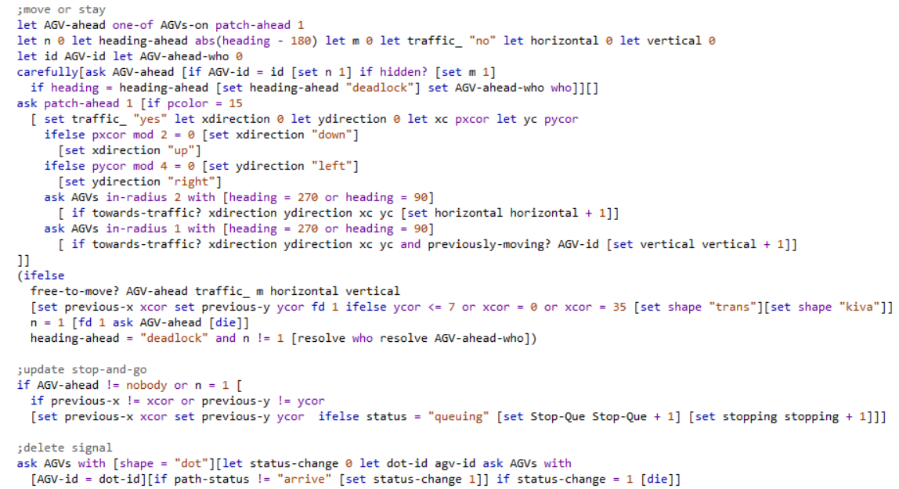
Not-collide
Check for collision
CODE
CODE EXPLAINATION
let AGV-ahead one-of AGVs-on patch-ahead 1 : initialize variable using randomly chosen instance of AGVs-on patch-ahead
let n 0 let heading-ahead abs(heading - 180) let m 0 let traffic_ "no" let horizontal 0 let vertical 0 : initialize variable’s value
let id AGV-id let AGV-ahead-who 0 : initialize variable’s value
carefully[ask AGV-ahead [if AGV-id = id [set n 1] if hidden? [set m 1] : do first command if it’s return error do second command instead
if heading = heading-ahead [set heading-ahead "deadlock"] set AGV-ahead-who who]][] : conditional checking, if return true do given command
ask patch-ahead 1 [if pcolor = 15 : command patch-command based given condition
[ set traffic_ "yes" let xdirection 0 let ydirection 0 let xc pxcor let yc pycor : Set given variable value
ifelse pxcor mod 2 = 0 [set xdirection "down"] [set xdirection "up"] : conditional checking, if return true do given command
ifelse pycor mod 4 = 0 [set ydirection "left"] [set ydirection "right"] : conditional checking, if return true do given command
ask AGVs in-radius 2 with [heading = 270 or heading = 90] [ if towards-traffic? xdirection ydirection xc yc [set horizontal horizontal + 1]] : Command AGV withing radius with given condition to do given command
ask AGVs in-radius 1 with [heading = 270 or heading = 90] [ if towards-traffic? xdirection ydirection xc yc and previously-moving? AGV-id [set vertical vertical + 1]] : : Command AGV withing radius with given condition to do given command

Slide 52
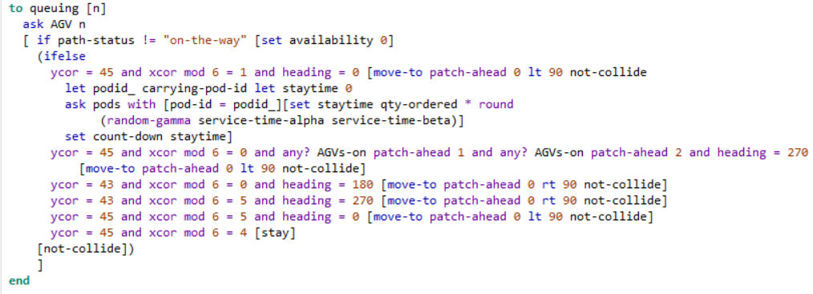
Queuing
Function for simulation queue
CODE
CODE EXPLAINATION
ask AGV n [ if path-status != "on-the-way" [set availability 0] : Command n-th AGV to do given command
(ifelse
ycor = 45 and xcor mod 6 = 1 and heading = 0 [move-to patch-ahead 0 lt 90 not-collide let podid_ carrying-pod-id let staytime 0 ask pods with [pod-id = podid_][set staytime qty-ordered * round (random-gamma service-time-alpha service-time-beta)] set count-down staytime] : First condition and command
ycor = 45 and xcor mod 6 = 0 and any? AGVs-on patch-ahead 1 and any? AGVs-on patch-ahead 2 and heading = 270 [move-to patch-ahead 0 lt 90 not-collide] : : second condition and command
ycor = 43 and xcor mod 6 = 0 and heading = 180 [move-to patch-ahead 0 rt 90 not-collide] : third condition and command
ycor = 43 and xcor mod 6 = 5 and heading = 270 [move-to patch-ahead 0 rt 90 not-collide] : forth condition and command
ycor = 45 and xcor mod 6 = 5 and heading = 0 [move-to patch-ahead 0 lt 90 not-collide] : fifth condition and command
ycor = 45 and xcor mod 6 = 4 [stay] : sixth condition and command
[not-collide]) ] : If no other condition fulfilled and do this command

Slide 53
Thank You
Ryanda
Industrial Management Department
Center for Internet of Things Innovation
National Taiwan University of Science and Technology

